Slide 1

Support Ticket Admin Panel
A comprehensive web-based system for streamlined ticket management and resolution
github.com/Zuveriya-Tabassum/support-ticket

Slide 2

Project Overview
What We Built
The Challenge
The Support Ticket Admin Panel is a sophisticated web-based solution designed to revolutionise how organisations manage customer support requests. It provides administrators and support teams with a centralised platform to efficiently handle, assign, and resolve tickets whilst maintaining complete transparency throughout the process.
Traditional manual ticket management systems suffer from significant inefficiencies: delayed response times, inconsistent assignment practices, poor visibility into ticket status, and lack of accountability. These issues directly impact customer satisfaction and team productivity.

Slide 3

Project Objectives
Centralised Management
Intelligent Automation
Create a unified platform where all support tickets are visible, searchable, and manageable from a single intuitive dashboard interface.
Implement smart ticket assignment capabilities that route requests to the most appropriate admin or support agent based on workload and expertise.
User-Centric Design
Profile Management
Deliver a responsive, intuitive interface that works seamlessly across desktop and mobile devices whilst ensuring accessibility for all users.
Enable comprehensive profile customisation and real-time status tracking to enhance team coordination and accountability.

Slide 4
Core Features & Capabilities
1
2
Secure Authentication
Intuitive Navigation
Robust user and admin authentication system with role-based access control ensuring data security and proper permissions management.
Comprehensive sidebar navigation providing quick access to dashboard, user management, and ticket oversight functionality.
3
4
Ticket Operations
Profile Customisation
Complete ticket lifecycle management including assignment, status updates, and closure with detailed tracking capabilities.
Full admin profile management supporting photo uploads, personal information updates, password changes, and biographical details.
5
6
Theme Flexibility
Responsive Design
Dark and light mode toggle allowing users to customise their viewing experience based on preference and environment.
Adaptive styling ensuring optimal user experience across desktop, tablet, and mobile devices with consistent functionality.

Slide 5
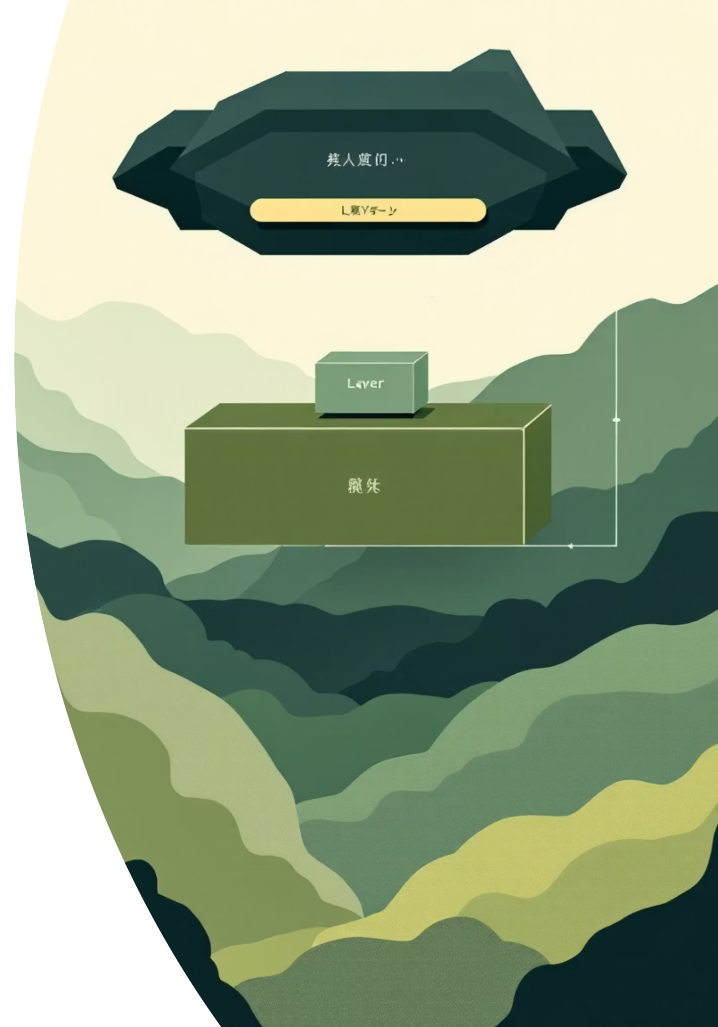




System Architecture
Frontend Layer
HTML5, CSS3 & JavaScript – Responsive user interface with dynamic interactions and real-time updates
Backend Framework
Python Flask – Lightweight yet powerful web framework handling routing, authentication, and business logic
Data Persistence
MySQL/SQLite with SQLAlchemy ORM – Robust database management with object-relational mapping for efficient queries
Version Control
GitHub – Collaborative development platform ensuring code versioning, backup, and team coordination

Slide 6

Technology Stack
Backend Technologies
Frontend Technologies
Development Tools
Python Flask – Core framework
HTML5 – Semantic markup
Git – Version control
SQLAlchemy ORM – Database abstraction
GitHub – Code repository
CSS3 – Custom styling
Flask CLI – Development server
MySQL/SQLite – Data storage
JavaScript – Dynamic interactions
This modern technology stack was carefully selected to balance performance, maintainability, and scalability whilst ensuring a smooth development experience and robust application architecture.

Slide 7
Ticket Lifecycle Workflow
01
02
03
Ticket Creation
Dashboard Display
Review & Assignment
User submits a support request through the system interface with relevant details and priority level
Ticket immediately appears in the admin dashboard with all pertinent information visible for review
Administrator reviews ticket details and assigns it to the most appropriate support agent or team member
04
05
Status Management
Resolution & Closure
Ticket status is maintained and updated throughout its lifecycle: Open, In-Progress, or Closed
Support agents or admins resolve the issue and mark the ticket as closed with resolution notes

Slide 8
User Interface Showcase
The admin panel features a clean, modern interface designed for efficiency and ease of use across all core functions.
Admin Dashboard
Navigation & Theme Toggle
Ticket Assignment
Profile Management
Comprehensive overview with ticket statistics, recent activity, and quick-access controls
Card-based layout with dropdown selections for efficient ticket distribution
Customisable profile page with photo upload, personal details, and edit capabilities
Intuitive sidebar with dark/light mode switching for personalised viewing preferences

Slide 9
System Demonstration
Login
1
Secure authentication with role-based access
2
Dashboard
Overview of all tickets and system metrics
Manage
3
Assign, update, and track ticket progress
4
Profile
Customise settings and personal information
Reports
5
Generate insights and performance analytics
The application workflow is designed to minimise clicks whilst maximising efficiency. Users can navigate seamlessly between ticket management, assignment operations, and profile settings, with all critical information accessible within two clicks from the main dashboard.
d

Slide 10


Installation & Setup Guide
Clone Repository
Download the project from GitHub to your local machine
git clone https://github.com/Zuveriya-Tabassum/support-ticket
Set Up Environment
Create and activate a Python virtual environment for dependency isolation
python -m venv venvsource venv/bin/activate
Install Dependencies
Install all required packages using the requirements file
pip install -r requirements.txt
Launch Application
Start the Flask development server and access via browser
flask run
Access Interface
Open your web browser and navigate to the local server
http://localhost:5000
Note: Ensure Python 3.7+ is installed on your system before beginning the setup process. Database configuration may require additional steps depending on your choice of MySQL or SQLite.

